Slide 1
Ambergrid Traffic Management System
A proposed project for automated traffic control system by group 06

Slide 2
Group members:
Name | Roll | ID
Tasnim Jarin | 08 | 19-39394-1
Md Mahmodul Kabir | 25 | 19-40642-1
Mohammad Sakib Islam Mazumder | 06 | 19-39290-1
Sazid Al Farabi | 10 | 19-39478-1

Slide 3
Foreword:
The idea of implementing an Automated Traffic Management System had to be constructed from the ground up using Object Oriented Programming.
There are three actors of the system, namely Admin, Sergeant and Driver. The actors will have access to certain features and functions depending on needs and authority.
The system will be flexible to future updates and implementations. It will be accessible via cell phones and desktop, depending on the users.

Slide 4
Objective to be achieved
To design an efficient and effective traffic management system aiming to reduce vehicle congestion in urban areas.
The goal is to design an easy to use platform for users of the system that will enable to handle tasks swiftly.
The system is focused around time and cost saving.

Slide 5
Project Details (a) Users for the System
Admin: Supervisor of the system.
Will change the important signals.
Monitors actions and response.
Traffic Sergeant: Monitors system at field level.
Occasionally overrides signal in case of emergencies.
Give penalty to the driver according to law.
Check License of vehicles and drivers.
Driver: Liable to Sergeant and the system according to law.
Pays the fee in case of breaking law.

Slide 6
Project Details (b) Functionalities
Registration - Drivers will register themselves and their vehicles with proper information to the admin for being added to the system.
Signal Control - System does this automatically based on the vehicle density on a specific length segment. A road which reached the maximum of density level will be closed for new entry of vehicles. Admin can override signal for clearing a road.
Check License - Detect lawful drivers and validity of vehicles registration number. If any vehicles or driver without any valid registration number, it will be recognized as a law-break and notify sergeant for proper steps.

Slide 7
Project Details (b) Functionalities [Continued...]
Speed Check - Speeding vehicles above the limit will be automatically detected by system sensors. Unexpected detection will be informed to the Sergeant.
Penalty - Charged by Sergeant to Drivers who breaks the law. After getting notification, Sergeant will stop the vehicle on the next point and charge as per the rule.
Pay Fine - Fine paid by Driver for breaking the law. Driver will pay the fine by logging into the system’s payment structure. Payment will be confirmed by the Admin.
Login - Admin and Sergeants log in to the system to access their operations.

Slide 8
Project Details (b) Functionalities [Continued...]
Density - Monitor traffic density on roads based on length and congestion. In between the length of one signal-point to another signal-point, there will be a scale of density. If density reaches the highest scale, system will block the road for new entry. While density decreases, it will open automatically.
Emergency - Notified by First Responders to the System Admin in order to clear lanes for priority pass. If any first responder request for emergency move via a road, then system will turn on the special indicator for a specific lane. Any movement of general vehicles via emergency lane will be considered as a law-break.
Logout - Logout of the system for all user. No user will be able to perform any operation without logging in to the system.

Slide 9
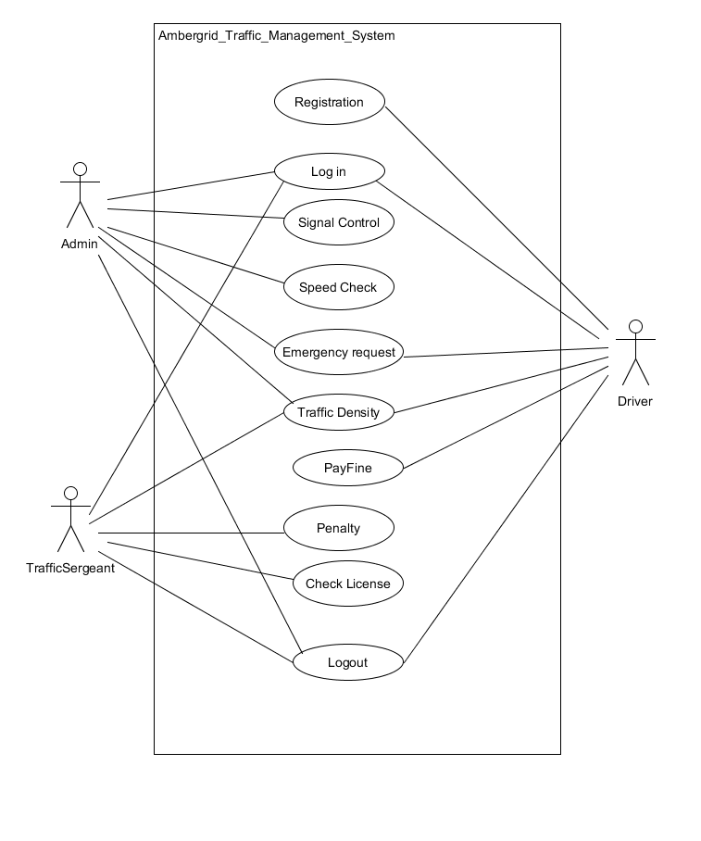
Project Details (b) Functionalities [Use Case Diagram]

Slide 10
Project Details (c) Contributions
Team members are dedicated to work with collaboration on the following tasks:
A : Identify project requirements a motive.
B : Find a suitable name for the project.
C : Define OCI (output/control/input).
D : Define functionalities and behavior.
E : Draw the UML diagrams.
F : Implementation state 01.
G : Implementation state 02.
H : Quick review.
I : Documentation.

Slide 11
Project Details (c) Contributions [Timeline]
Tasks | Week 01 | Wek 02 |  | Week 03 | Week 04
A | Mahmodul
B | Sakib
C |  | Tasnim |  | Sazid
D |  | Mahmodul |  | Sakib
E |  |  | Tasnim | Sazid
F |  |  | Sakib | Tasnim | Mahmodul
G |  |  | Sazid | Mahmodul | Sakib | Tasnim
H |  |  |  |  | Sazid | Tasnim
I |  |  |  |  | Sazid | Sakib

Slide 12
Limitations of the System
Inability to detect and update sensor data at this moment.
Dependency on a single platform.
Inability to clear signals by monitoring congestion/density.
Inability to clear emergency lanes controlled centrally.
Dependency on field level sergeants.
Dependency on local database.
Absence of a warning system for potential law break.

Slide 13
Future Implementation Goals
Hardware such as sensors for aiding the system.
Network system for accessing the system from anywhere.
Cloud based database for limiting risk of data loss.
Cross platform access for users of the system.
Automation and Artificial Intelligence for advanced functionality.
Implementing warning system for drivers in case of potential law breach.
Real time update on vehicle congestion in different areas.
Map based traffic monitoring system.
Radio overriding in vehicles to alert drivers about danger zones.

Slide 14
Thank You

